Slide 1
Dietary update for Diabetes
Lakshmi Chandrasekharan
Advanced Diabetes/Renal Specialist Dietitian & DAFNE Educator
Southend University Hospital NHS Foundation Trust.

Slide 2
Overview of Presentation
TYPE 1 Diabetes and Diet
-CHO Counting
-DAFNE
Type 2 Diabetes and Diet
  Current popular advice and guidelines
  What we often use now
  Starch AND sugar = carbohydrate = effect on BG rise
  [Hopefully] some practical tips
  Carbohydrate counting/awareness – an overview
Notes:
2
2

Slide 3
DAFNE
Dose Adjustment For Normal Eating
A structured education programme for People with Type 1 diabetes

Slide 4
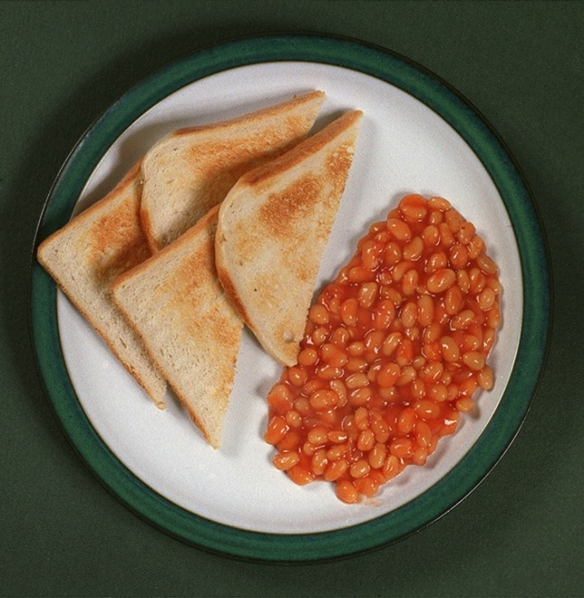
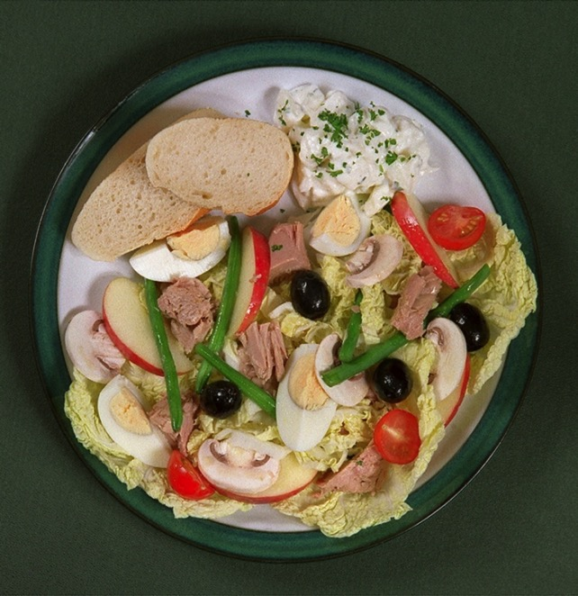
Would a TIDM patient need the same amount of insulin for these meals?

Slide 5
The DAFNE approach - food first test sugar levels, count CHO and then inject
Food
Blood glucose
Food
Food
BI
BI
QA
QA
QA
Notes:
5
The DAFNE approach gives food first and then just the right amount of insulin to keep the blood glucose level.
The background insulin is also split into two and roughly half given at night and half in the morning

Slide 6

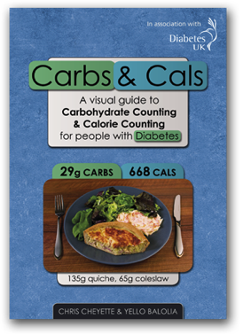

Resources that can help…
10 g list

Slide 7
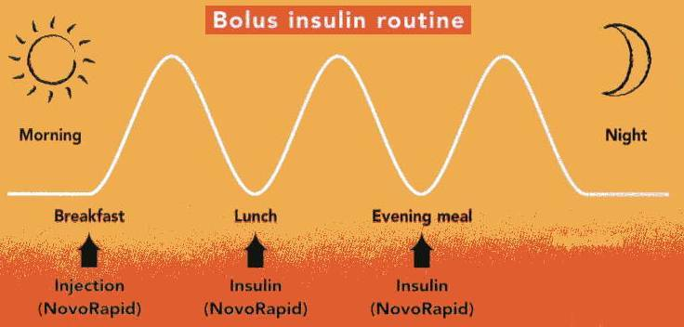
Basal insulin
Lantus
or
Levemir

Slide 8
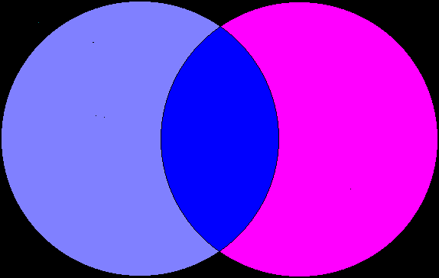
Type 2 Diabetes is a progressive metabolic disorder characterised by:
Insulin resistance
Type 2
diabetes
β-cell dysfunction

Slide 9
What is Type 2 Diabetes
Type 2 diabetes occurs when the pancreas doesn't produce enough insulin to maintain a normal blood glucose level or the body is unable to use the insulin that is produced (insulin resistance).

Slide 10
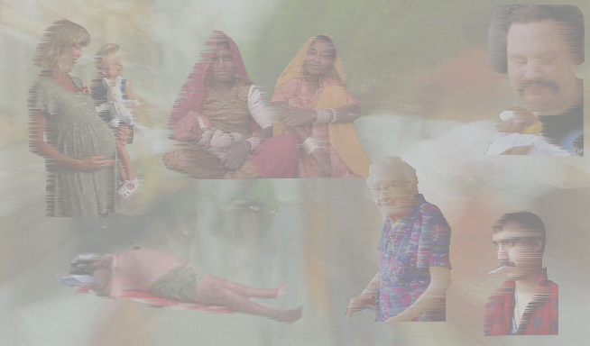
‘Risk Factors’ for Type 2 Diabetes
GESTATIONAL DIABETES AND PARITY
GENETIC FACTORS
- Ethnicity
- Family history (40%)
CENTRAL OBESITY
PHYSICAL INACTIVITY
INCREASING
AGE
Williams G, Pickup JC. Handbook of Diabetes. 2nd Edition, Blackwell Science. 1999.

Slide 11
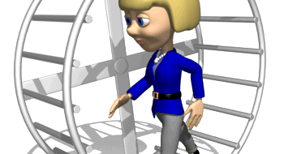
VISCIOUS CIRCLE!
INSULIN
RESISTANCE
TYPE 2 DIABETES
LESS PHYSICAL
ACTIVITY/EXERCISE
OBESITY

Slide 12
Why are we South Asians at risk of
Type 2 Diabetes
Heart diseases
Stroke

Slide 13
Risk Factors
Genetic Predisposition
Insulin Resistance
Overweight/Increased BMI
Increased waist measurements.
  (South Asian men > 90cm
  South Asian Women > 80cm)
Central obesity
Hyperinsulinaemia
Dyslipidemia
Blood pressure

Slide 14
Ten steps to eating well
with Type 2 diabetes (Diabetes UK, 2011)
Eat three meals a day
Include starchy carbohydrates/Low Glycaemic index foods as part of your diet
Cut down on the fat you eat, particularly saturated fats
Eat more fruit and vegetables
Include more beans and lentils
Aim for at least two portions of oily fish per week
Limit sugar or sugary foods
Reduce salt in your diet to 6g per day or less
Drink alcohol in moderation only
Don’t’ use diabetic foods or drinks

Slide 15
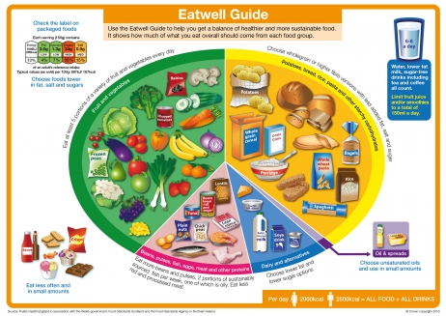
The Eatwell GUIDE
5 food groups
Pictorial representation of a balanced diet
Third of diet from fruit and veg
Third from starchy foods
Just less than a sixth from both milk and dairy and protein sources
Allowance for fats and sugars

Slide 16
What is Glycaemic Index
The glycaemic index (GI) is a method of ranking foods on a scale according to the extent to which foods raise blood glucose levels after taking a carbohydrate containing meal.

Slide 17
Classification of GI
High GI – CHO breaks down quickly and causes high blood glucose levels. e.g. cornflakes, jacket potatoes.
Low GI - CHO breaks down slowly and causes a smaller rise in blood glucose levels. e.g. pasta, porridge
Intermediate GI – As the name implies, somewhere in between. e.g digestive biscuits, boiled potatoes.
Notes:
17
17

Slide 18
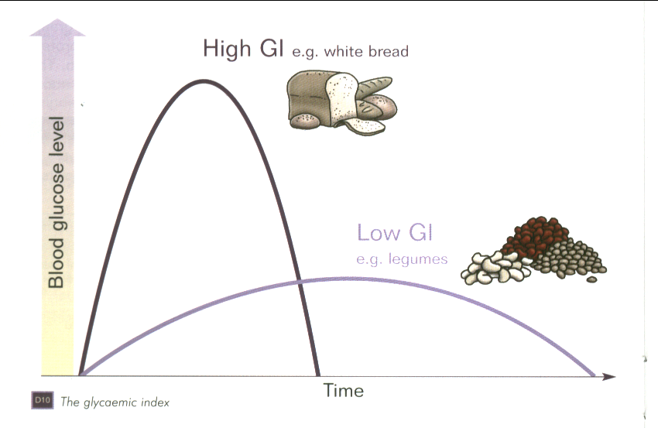
Glycaemic Index

Slide 19
Glycaemic Index
LOW (0-55)
Rich Tea Bisc
Chapatti
Venpongal
Pesarattu
All bran
Porridge
Pasta
Basmati Rice
Sweet corn, beans& lentils
Apple Mango Orange Grapes
MOD (56-69)
Digestive bisc
Ryvita
Shredded wheat
Instant oats
Boiled/new potatoes
Couscous
Beetroot
Millet
Idly
Dosa
Uppuma
Banana just ripe
Melon
Raisins
HI (70-100)
Water biscuit
Rice cake
Cornflakes
Puffed Rice
Jacket/mashed potatoes
White rice
Parsnip/ Pumpkin
Watermelon Lychees
Over-ripe banana

Slide 20
Advantages of Low GI diet
Low GI diets have been shown to reduce HbA1C.
(Explain HbA1C briefly and consequences of poorly controlled diabetes)
Consumption of a low GI diet influences satiety and reduces subsequent food intake.
Low GI diet may be useful for weight loss and weight maintenance.*

Slide 21
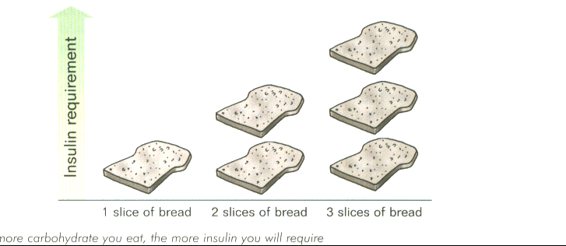
More carbs….....
more glucose in blood…..
More calories ……..
More weight gain ……..
Notes:
21

Slide 22
[Perhaps] a useful fact!
We know that in someone with Diabetes 10g of carbohydrate will increase blood glucose levels by 2-3mmol/l.

Slide 23
Evidence-based nutrition guidelines for the prevention and management of diabetes (Diabetes UK, 2011)
120-130g total carbohydrate per day.
Should enable an individual to consume a balanced diet that provides sufficient energy, essential vitamins and minerals and fibre.

Slide 24
Primary Treatment for T2DM
Weight management is the primary nutritional strategy in managing Type 2 Diabetes for those who are overweight and obese.

Slide 25
Energy balance
Energy Balance = Energy Intake – Energy Expenditure
You will be in positive energy balance when energy intake exceeds energy expenditure
Positive energy balance leads to obesity

Slide 26
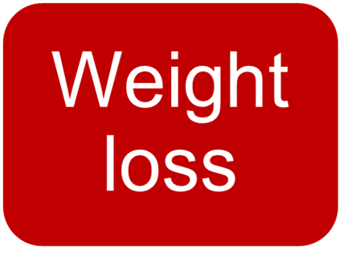
The panacea?

Slide 27

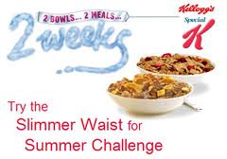





Practical tip
No evidence to which diet works best

Slide 28
Fruit (and chocolate!)
Food | CHO (g) | Calories
80g Grapes | 10-15 | 50
1 medium apple | 15 | 62
1 large banana | 20 | 100
2 finger kit kat | 15 | 107
CAN eat grapes and bananas
Portion size
1 portion = 80g/small handful
2-3 portions spread out during the day
Have as snacks between meals
Low GI – fructose and fibre
Top tip! can eat chocolate!! in moderation as the advise is a low sugar diet and not a sugar free diet.

Slide 29
All about the orange!
Food | CHO (g) | Calories
1 orange | 10 | 30
200ml orange juice | 20 | 95
250ml NAS squash | 3 | 17
Fruit juice
  Unsweetened - sugar not added but natural sugars often high
  No different between luxury from concentrates and not from concentrates
Fruit juice does count as one of your five a day but allow maximum of 150-200ml per day)
No added sugar (NAS) squash may contain a little natural sugar from the fruit used
Top tip! Choose No added sugar squash

Slide 30
Most important meal of the day!
Food | CHO (g) | Calories
3 Weetabix | 42 | 201
200ml semi skimmed milk | 10 | 92
Idli/Sambhar ?Poori/Potato Curry Dosai/ ?Masala Vadai??
  All about the portion size
  Cooked South Indian breakfast ??
  Negotiate a healthier version for reduced calorie treat

Slide 31
White, brown, 50:50 or granary?
Food | CHO (g) | Calories
Thick slice of wholemeal bread | 20 | 106
Medium slice of white bread | 15 | 72
Medium slice of granary | 15 | 78
Wholemeal or granary are higher in fibre
For blood glucose and weight loss the most important thing is the thickness of the slice
Top tip! Swap thick slice for medium.

Slide 32
Carbohydrate awareness or Carbohydrate confusion?
Carbohydrate awareness
Raising awareness of all foods that affect blood glucose levels.
This is often the ‘bit’ people do not understand.

Slide 33
Carbohydrate Loading in Indian foods
A typical South Indian meal.
  Rice
  Chappathi
  Potato curry
  Pakoras
  Pappad

Slide 34
Carbohydrate Loading in Indian foods
Idly
Dosai
Poori
Uppuma
Venpongal
Mango lassi
Payasam
Gulab jamun or similar indian sweets

Slide 35
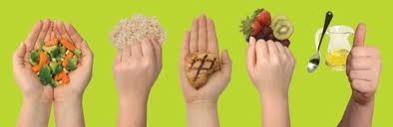
Practical tip
No need to weigh – use your hands

Slide 36
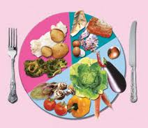
Practical tip
Fill your plate with vegetables/salad

Slide 37
Summary
People need to understand that both sugary and starchy foods increase their blood glucose.
Portion size and the type of carbohydrates are the MOST important factors.
By focusing on this we can hopefully improve glycemic control AND encourage weight loss.

Slide 38
Put a traffic light on every food label
All measures per 100g | Low – A healthier choice | Medium – Ok most of the time | High – Just occasionally
Sugars | 5g or less | 5.1g – 15g | More than 15g
Fat | 3g or less | 3.1 – 20g | More than 20g
Saturates | 1.5g or less | 1.6g – 5g | More than 5g
Salt | 0.30g or less | 0.31g – 1.5g | More than 1.5g
Traffic light labels on foods make it easier to choose healthy options. To apply traffic lights to a product, look at the ‘per 100g’ information panel on the pack and use this grid to make a healthier choice.
Information from British Heart Foundation

Slide 39
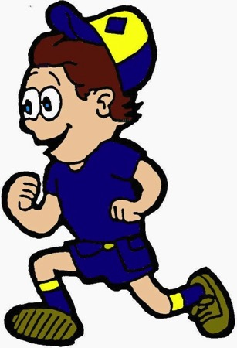
Incorporate Exercise in your lifestyle
What are the benefits of Exercise?
Improves glycaemic control/increases insulin sensitivity.
Improves Blood pressure
Improves Cholesterol level
Reduces weight
Reduces risks of CVD
Reduces Depression
Boosts self esteem/confidence – endorphins

Slide 40


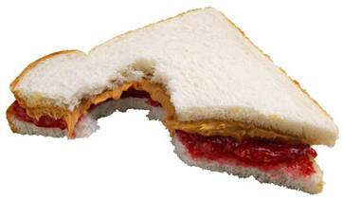
Hypoglycaemia
Sweating
Hunger
Palpitations
Trembling
Dizziness
Blood glucose – below 3.5 mmol/l

Slide 41
Hypoglycaemia
Blood sugar level <4mmol/l with or without symptoms
Treatment: (Rapid acting carbohydrates 15 -20g))
  150ml Cola drinks
  160ml fruit juice
  125ml Lucozade
  4 x 5g dextrose tablets
  5 fruit pastilles
  3-4 jelly babies
  8 jelly beans
Check blood sugar level after 10-15mins
If BG levels continue to be below 4mmol/l, repeat treatment
If not due for a meal, take a carbohydrate containing snack, e.g- 2 Rich tea or digestive biscuits or a fruit.

Slide 42
Diabetes and treatment
Diet only
Diet and Oral hypoglycaemic agents
DPP4 Inhibitors
GLP1 anologue
SGLT2 Inhibitor
Diet and Insulin
DIET is the cornerstone in the management of diabetes

